Slide 1
SSD-Insider: Internal Defense of Solid-State Drive against Ransomware with Perfect Data Recovery
Trubachev Ilya 818, Nazarov Konstantin 818
Gazizov Yakov 818, Oparina Daria 818

Slide 2
Agenda

Slide 3
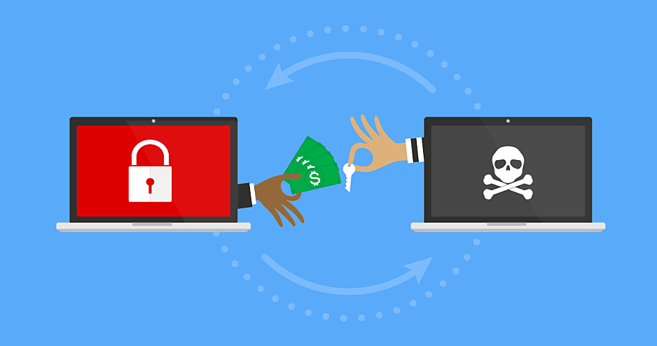
What is Ransomware?
malware that encrypts victim’s data, where the decryption key is released after a ransom is paid by the data owner to the attacker
ransomware encrypts data using strong encryption algorithms
ransomware tries to subvert standard malware defenses by using networks that utilize anonymous communication systems such as Tor
thieves collect ransom using cryptocurrency, such as Bitcoin, which is very difficult to track

Slide 4


Project motivation
Many ransomware attacks were reported recently.
Even after obtaining the secret key, there is no guarantee the data will be recovered completely.
Even IF THE RANSOM IS PAID there is no guarantee the secret key will be obtained

Slide 5
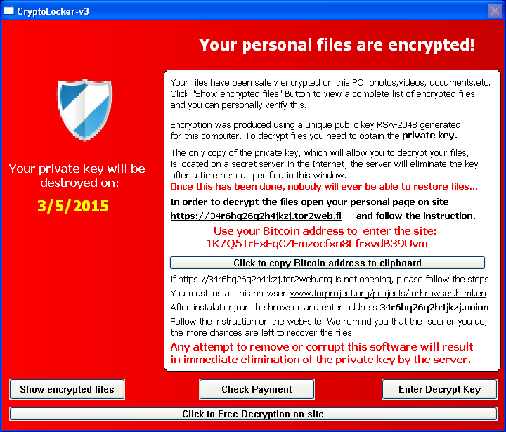
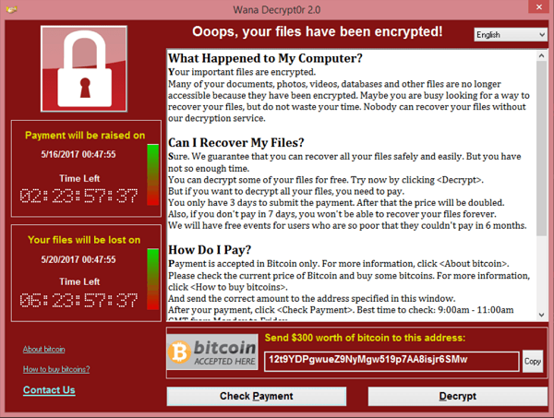
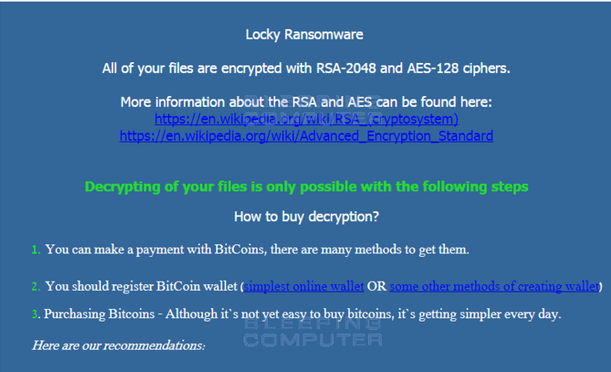
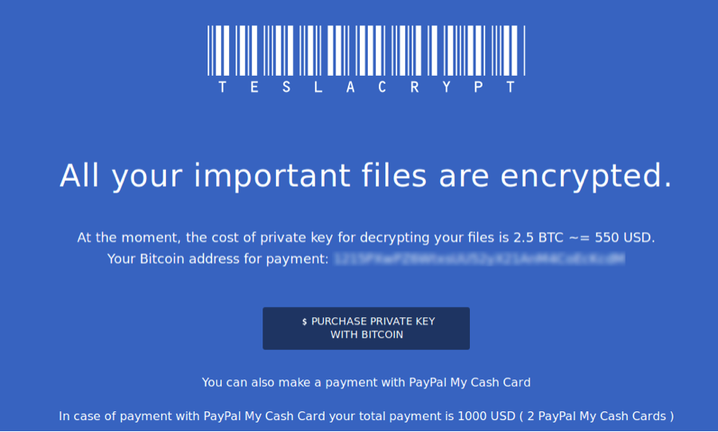

Slide 6
Examples of crypto ransomware
WannaCry
CryptoWall
TeslaCrypt (a.k.a. AlphaCrypt)
Locky

